Slide 1

UVM-Based Functional Verification of PCIe PHY Layer
Nanotechnology and Nanoelectronics Engineering
Presented By:
Marwan Eid 201901246
Peter Gad 201901588
Alaa Taha 201900983
Momen Allam 201900102
Mahmoud Marzouk 202000258
Supervised By:
Dr. Rania Hassan
Eng. Sherif Hosny
Dr. Hassan Mostafa

Slide 2
Contents
1
Introduction
4
Verification Approach
2
3
Existing RTL Design
Tasks and Schedule
5
6
Block-Level Verification
Chip-Level Verification
7
8
Conclusion and Future Work
References
‹#›

Slide 3
01
Introduction
PCIe and PHY Sub-Block
‹#›

Slide 4
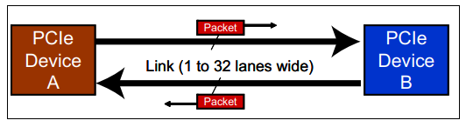
Introduction: PCIe
PCIe refers to Peripheral Component Interconnect Express.
PCIe is a high-speed interconnect technology used to connect various devices within a computer system.
This technology offers a standardized, point-to-point serial interface for data transmission.
Because it is a dual‐simplex connection, each interface has a simplex transmit path and a simplex receive path.
As illustrated in figure 1, the path between the devices is called a Link.
Figure 1: PCIe Dual-Simplex Link.
Obtained from: M. Jackson and R. Budruk, PCI Express Technology, MindShare, Inc., 2012.
‹#›
M. Jackson and R. Budruk, PCI Express Technology, MindShare, Inc., 2012.

Slide 5
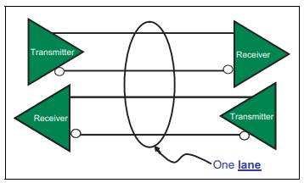
Introduction: PCIe
Each pair of wires is called a Lane.
The number of lanes is called the Link Width and is represented as x1, x2, x4, x8, x16, and x32.
Each Lane uses differential signaling as depicted in figure 2.
This helps improve noise immunity and reduce signal voltage.
Figure 2: PCIe Differential Lane.
Obtained from: M. Jackson and R. Budruk, PCI Express Technology, MindShare, Inc., 2012.
‹#›
M. Jackson and R. Budruk, PCI Express Technology, MindShare, Inc., 2012.

Slide 6
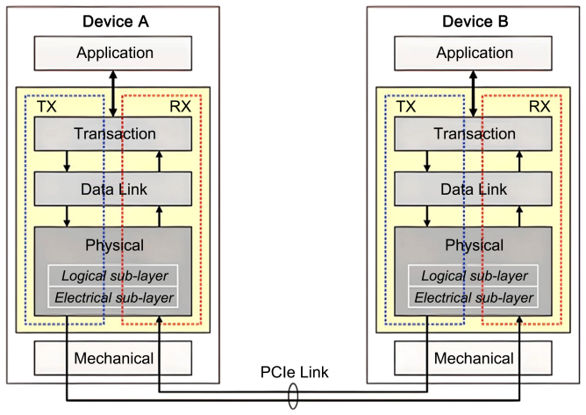
Introduction: PCIe Layers
PCIe employs a layered protocol architecture.
Consists of the Physical Layer (PHY), Data Link Layer (DLL), and Transaction Layer (TL), as illustrated in figure 3.
Each layer is responsible for specific functions and protocols.
The layers ensure reliable data transmission, accurate error detection and correction, flow control, and transaction management.
Figure 3: PCIe Layered Architecture.
Obtained from: S. N. Nag, "Technical Analysis of PCIe to PCIe 6: A Next-Generation Interface Evolution," World Journal of Engineering and Technology, vol. 11, pp. 504-525, 2023.
‹#›
S. N. Nag, "Technical Analysis of PCIe to PCIe 6: A Next-Generation Interface Evolution," World Journal of Engineering and Technology, vol. 11, pp. 504-525, 2023.

Slide 7
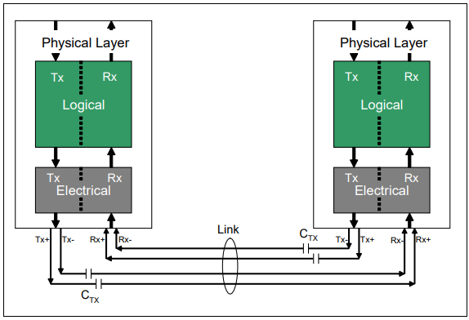
Introduction: PCIe PHY Layer
The Physical Layer is the bottom layer of the architecture of PCIe devices.
On the transmitter side of this layer, outbound packets are framed, encoded, scrambled, clocked, and serialized onto the available lanes.
While on the receiver side, inbound bit streams are recovered into the original packets, which are further forwarded to the DLL.
The Electrical sub-block is the analog interface of the Physical Layer that connects to the Link.
Figure 4: Physical Layer Sub-blocks.
Obtained from: M. Jackson and R. Budruk, PCI Express Technology, MindShare, Inc., 2012.
‹#›
M. Jackson and R. Budruk, PCI Express Technology, MindShare, Inc., 2012.

Slide 8
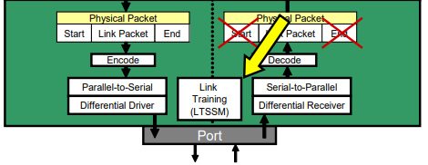
Introduction: PCIe PHY Layer - Logical
The key decision maker for the Physical Layer.
Consists of a transmit unit, a receive unit, and an LTSSM unit.
LTSSM takes the spotlight as the intelligence behind establishing and maintaining PCIe connections.
LTSSM generates control signals that determine the type and content of transmitted data (data packets, Logical Idle, and ordered sets).
Figure 5: PCIe PHY Layer.
Obtained from: M. Jackson and R. Budruk, PCI Express Technology, MindShare, Inc., 2012.
‹#›
M. Jackson and R. Budruk, PCI Express Technology, MindShare, Inc., 2012.

Slide 9
02
Existing RTL Design
The Design Under Verification (DUV)
‹#›

Slide 10
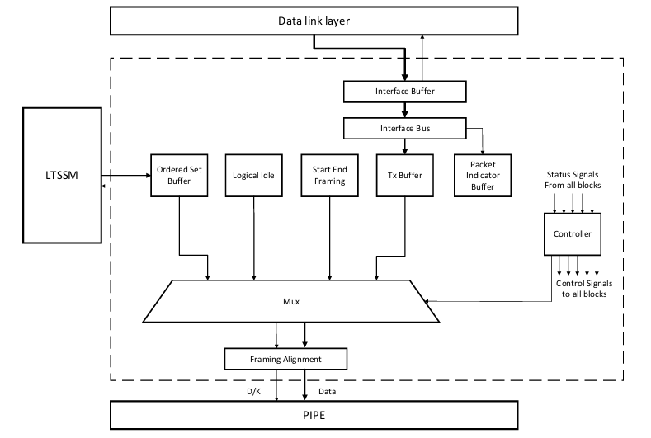
Existing RTL Design
The given design was implemented by a team from Cairo university in 2021 and supervised by Siemens EDA.
The RTL was provided by Dr. Hassan Mostafa for us to work on.
The design consists of LTSSM, Tx, and Rx.
Two modules were designed and integrated in the Tx, the encoder and the scrambler.
‹#›

Slide 11
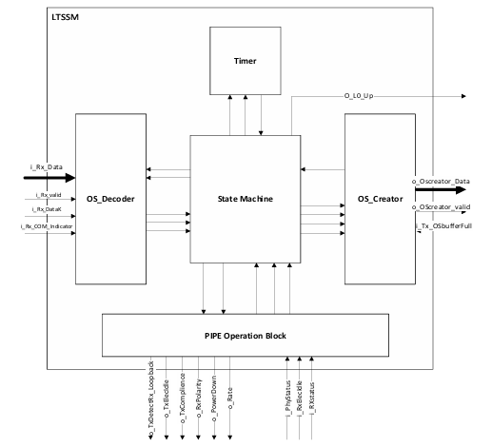
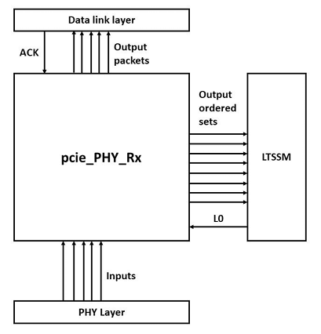
Existing RTL Design
The design consists of LTSSM, Tx, and Rx.
‹#›

Slide 12
03
Tasks and Schedule
Team Members Participation and Gantt Chart
‹#›

Slide 13
Project Tasks
Learning verification concepts, SystemVerilog, and UVM.
Understanding the operation and architecture of PCIe.
Examining the design to be verified for completeness.
Design and integration of any missing mandatory functionalities or features.
Breaking down the design into well-defined blocks.
Writing detailed specification documents and implementing reference models for each block.
Developing verification plans for each block.
Conducting block-level verification for all blocks.
Reporting bugs and coverage results.
Fixing bugs in the RTL (whenever possible) and reevaluating the fixed modules for functionality.
Performing chip-level verification for the LTSSM.
‹#›

Slide 14
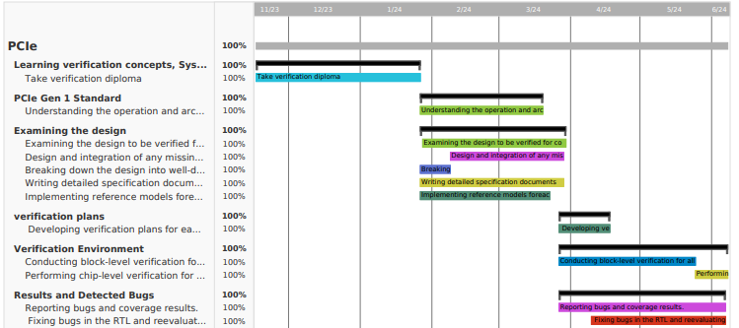
Gantt Chart
‹#›

Slide 15
04
Verification Approach
Verification Methodology and Testbench Architecture
‹#›

Slide 16
Verification Approach
A coverage-driven constrained random functional verification methodology is employed.
A UVM-based verification environment is used.
Verification will be performed using Mentor QuestaSim as the primary simulator.
Functional coverage of 100% and code coverage of 90% are required as exit criteria.
Multi-agent UVM environments are essential due to the complicated communication among modules.
Designed with reusability in mind, the agents in block-level environments can be set active or passive depending on the scenario.
In block-level scenarios, all agents operate actively, whereas in chip-level verification, some are intentionally set to passive mode.
‹#›

Slide 17
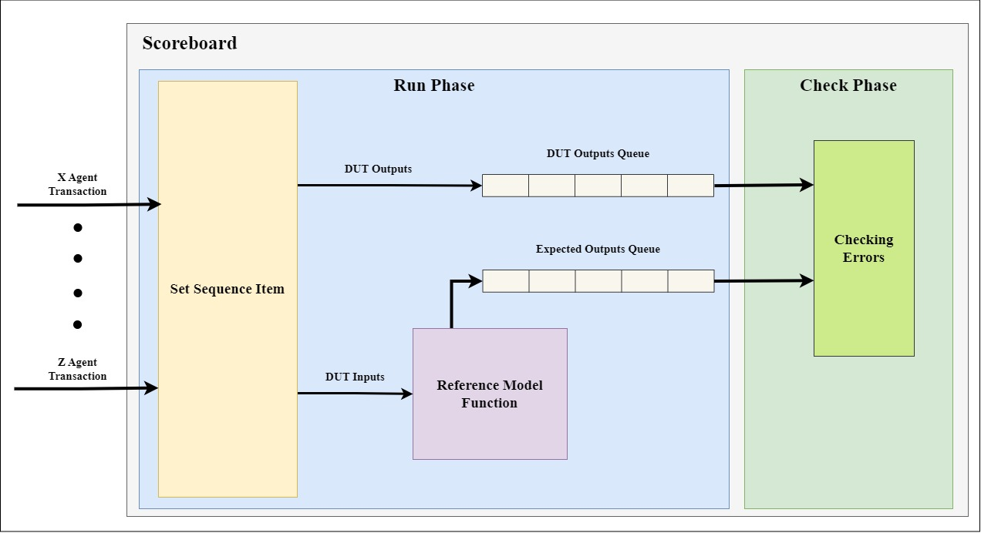
Verification Approach: Checking Mechanism
‹#›

Slide 18
05
Block-Level Verification
Verification of Blocks Such as Decoder, Creator, and Tx Buffers
‹#›

Slide 19
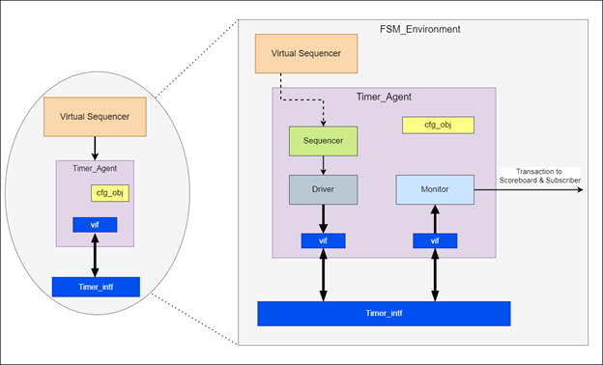
Block-Level Verification: Agent
In any verification environment designed to test the functionality of a single block, multiple agents are employed to mimic the communication behavior between the block of interest and other blocks.
For example, a global agent is implemented to manage the sequence of global signals, such as clock, reset, and the type of device (upstream or downstream) signals.
‹#›

Slide 20
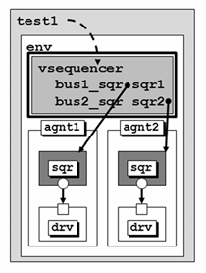
Block-Level Verification: Virtual Sequencer
Due to the presence of multiple agents in a single environment, coordinating stimulus between different drivers is essential.
This coordination is achieved through the implementation of virtual sequencers that manage the agents’ sequencers by executing individual sequence items on a driver via a sequencer port.
The overall coordination of the various sequences is handled within a virtual sequence defined inside the test.
Figure 7: Virtual Sequencer.
Obtained from: C. E. Cummings and J. Bergeron, “Using UVM virtual sequencers and virtual sequences,” Sunburst Design, 2016
‹#›

Slide 21
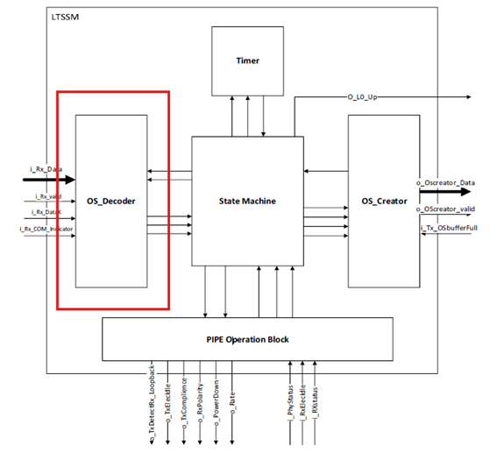
Block-Level Verification: OS Decoder
Design Description:
This IP receives data from the PCIe Rx and the state machine.
Based on the data’s content and the current state, it controls the state transitions during link training and initialization process.
‹#›

Slide 22
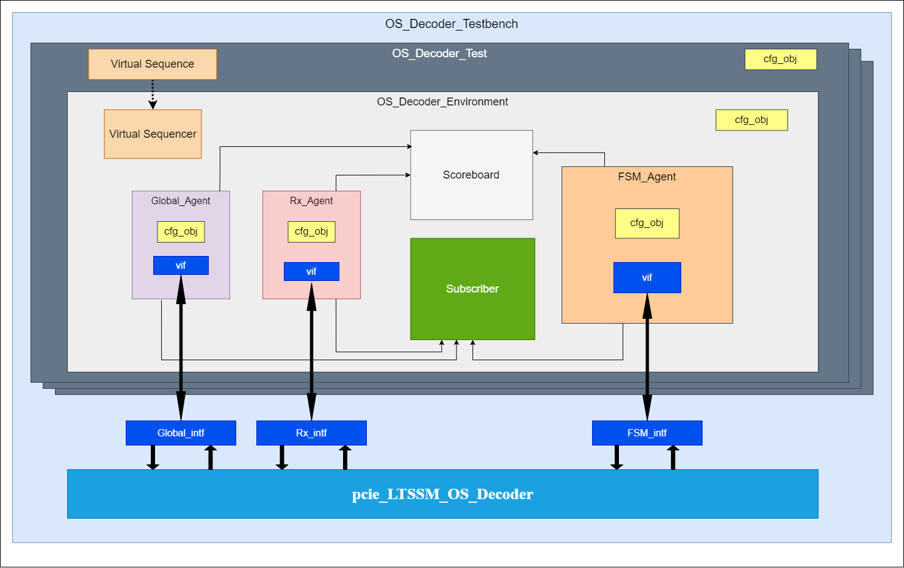
Block-Level Verification: OS Decoder
Verification approach:
In this block-level environment, 3 active agents are used to interact with the Decoder Module through 3 interfaces combining all input and output signals of the Decoder.
The agents are:
Global
FSM
Rx
‹#›

Slide 23
Block-Level Verification: OS Decoder
Detected Bugs:
Lane/Link errors:
When the decoder is reset, the lane numbers are initiated to 0, however, it should take its default value which is PAD (8h’f7).
When an 8x sequence is sent and then followed by a 9x sequence, the second sequence is shifted, and the lane, and ack are ruined.
Lane should be updated after sending a fully processed TS1, however in the RTL, it is updated a cycle late (lanenum wait to lanenum accept transition).
Link should be updated after sending a fully processed TS1, however in the RTL, it is updated after the second TS1.
‹#›

Slide 24
Block-Level Verification: OS Decoder
Detected Bugs:
Ack errors:
When a complete sequence is sent, Ack is asserted for only one sequence and then de-asserted which shouldn’t happen, ack signal should still be high until state change signal is asserted.
The transition from config complete to config idle needs 1xTS2/Lane/Link then 8xTS2/Lane/Link, however, the ack is raised after 7xTS2/Lane/Link only.
In the polling active state, after sending 8xTS1/PAD/PAD the ack signals get asserted but when we start sending 8xTS1/PAD/PAD (to go to the config state) the ack signal is not de-asserted, it is kept at 01 for the whole sequence and then gets de-asserted when next sequence is sent.
The transition from config idle to L0 states should receive 1xIDLE then 4xIDLE. However, the first Ack signal (2’b01) don’t appear except after receiving 2xIDLE not 1xIDLE.
‹#›

Slide 25
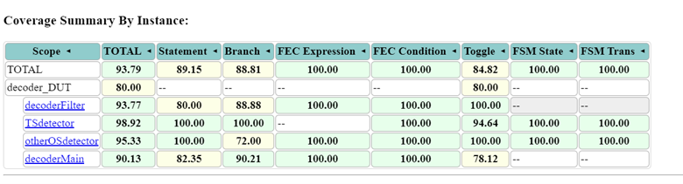
Block-Level Verification: OS Decoder
Evaluation:
All bugs were resolved.
Code Coverage = 93.8% and Functional Coverage = 100%.
‹#›

Slide 26
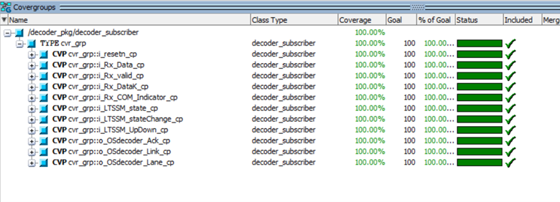
Block-Level Verification: OS Decoder
Evaluation:
This module is good to go.
‹#›

Slide 27
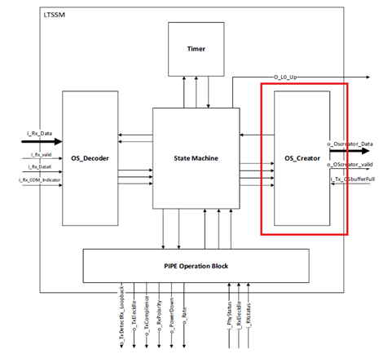
Block-Level Verification: OS Creator
Design Description:
This module is responsible for creating the required Ordered-Sets (OS) to complete the training process. It serves as an interface between the LTSSM and the Tx.
The Creator is composed of 3 sub-modules, one for the creation of Training Sequence (TS) OS, the second one for the creation of other OS, and the third for creating the logical idle symbols.
‹#›

Slide 28

Block-Level Verification: OS Creator
Verification approach:
In this block-level environment, 3 active agents are used to interact with the OS Creator Module through 3 interfaces combining all input and output signals of the Creator.
The agents are:
Global
FSM
Transmitter Tx
‹#›

Slide 29
Block-Level Verification: OS Creator
Detected Bugs:
Data Errors:
Sending some OS, resetting, and then sending another OS leads to an incorrect first OS (all zeros) even with disabling the module, resetting TS count, and asserting LTSSM state change.
If buffer full is indicated during sending multiple OS, the data out is not zeros as it should be.
Sending multiple OS, the data out is a repeated OS even after it is finished and the acknowledge is asserted. The output should be all zeros instead.
Ack Errors:
For sending LIDLE, having i\_OSreqNum = 1 is the same as i\_OSreqNum = 2 as we already send 2 LIDLE symbols in a single transaction, same goes for any 2 consecutive numbers (3 and 4, 5 and 6, ....).
Valid Errors:
The valid signal remains asserted even after the OS is finished. It should be de-asserted directly after the OS is finished.
‹#›

Slide 30
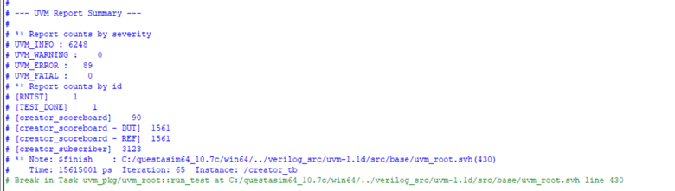
Block-Level Verification: OS Creator
Evaluation:
Resolving Bugs:
Most of the bugs are resolved, however, there were some bugs that were beyond resolving and needs a drastic change to the RTL.
After resolving most of the bugs, the errors decreased from 1240 to 89 errors as shown in the figure below.
‹#›

Slide 31
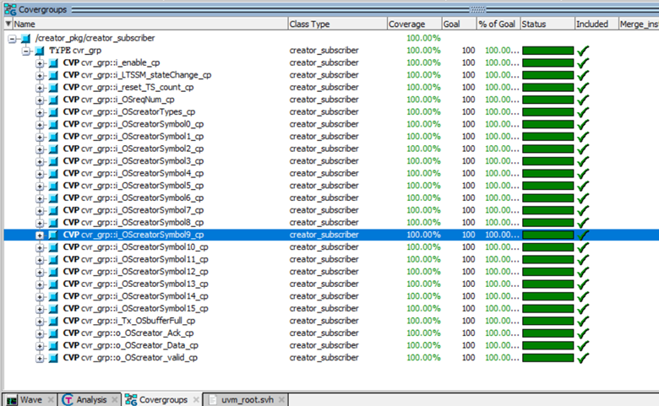
Block-Level Verification: OS Creator
Evaluation:
Functional Coverage:
‹#›

Slide 32
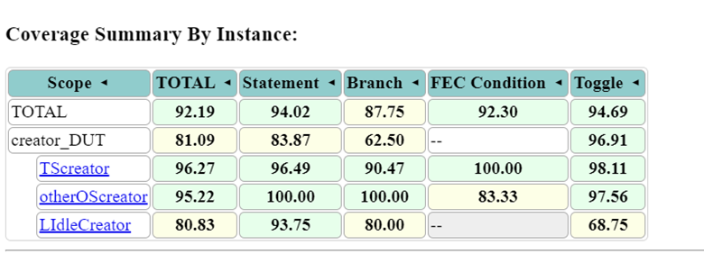
Block-Level Verification: OS Creator
Evaluation:
Code Coverage:
‹#›

Slide 33
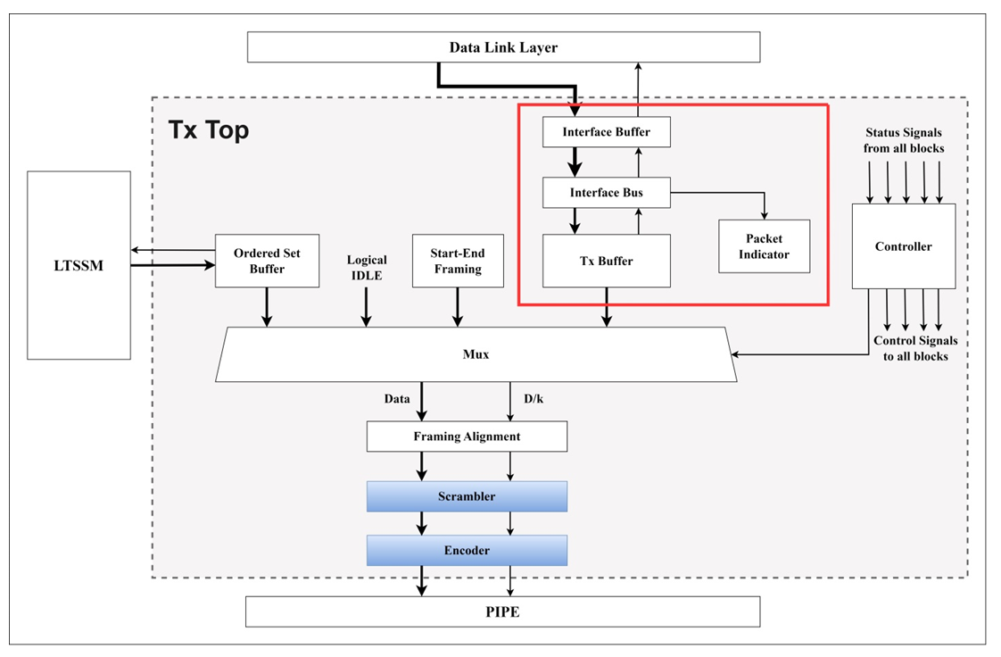
Block-Level Verification: Buffers
Design Description:
The buffers module collection is a group of four modules in the PCIe transmitter IP that have been grouped together for verification purposes. The position of the modules in the transmitter architecture is shown in the figure . They are responsible for receiving and splitting the incoming packet from the DataLink layer.
‹#›

Slide 34
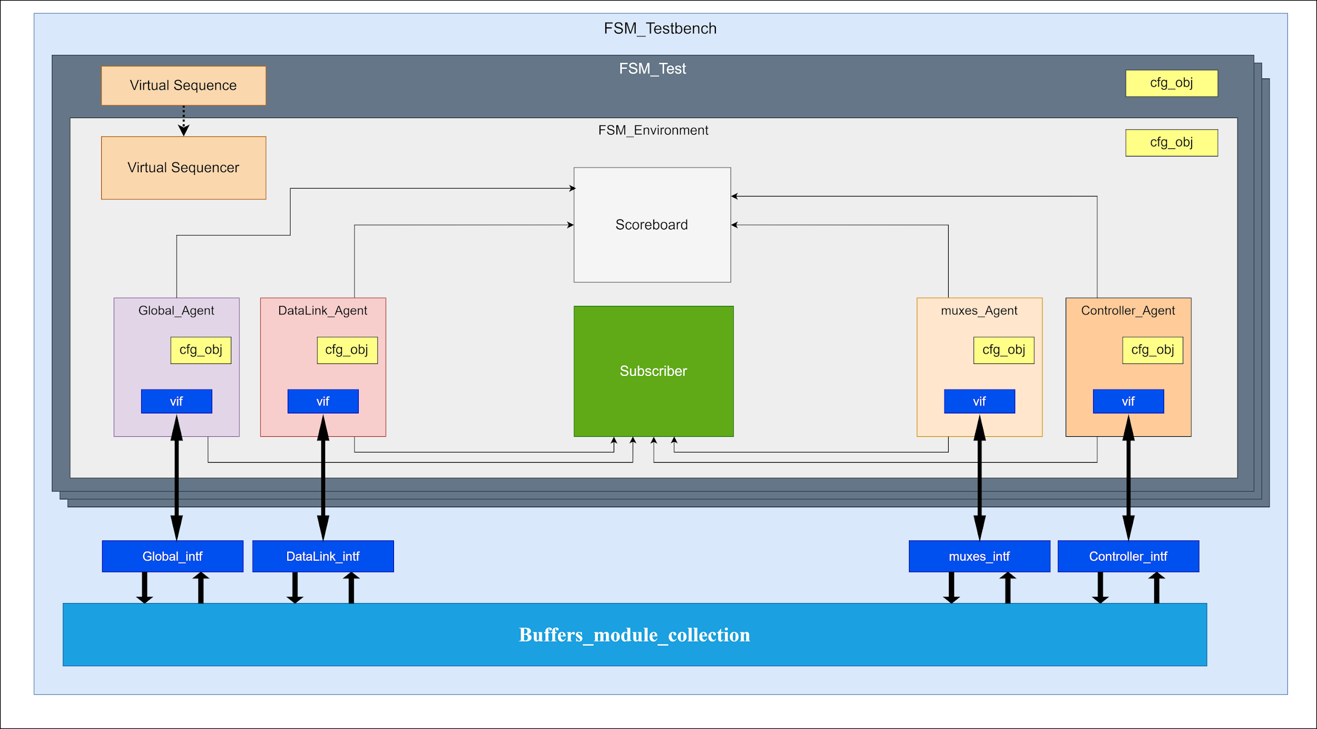
Block-Level Verification: Buffers
Verification approach:
Separate agents will be used for every independent module that the DUT interacts with (The DataLink layer, the controller, and the muxes collection). Additionally, a global agent was implemented to manage the clock and reset signals. So the buffers environment will have 4 agents in total All these agents are active.
‹#›

Slide 35
Block-Level Verification: Buffers
Detected Bugs:
Start/End indicators:
It was found that the interface bus switches the position of the START and END symbols during transmission.
RTL drives XXXXX:
It was found that the PI-buffer sends XXXXX values in the output when it has not been filled yet.
Both of these errors have been fixed and a new version of the RTL has been created.
‹#›

Slide 36
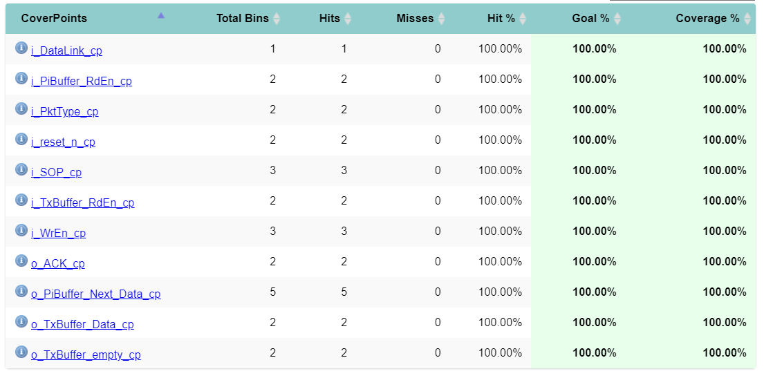
Block-Level Verification: Buffers
Evaluation:
Functional Coverage:
‹#›

Slide 37
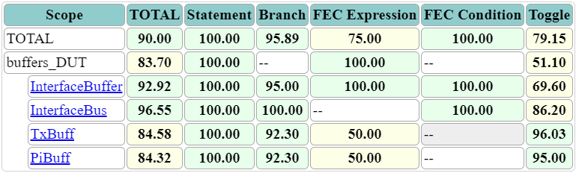
Block-Level Verification: Buffers
Evaluation:
Code Coverage:
As for the code coverage, we first had to add some exclusions to parts of the code that are impossible to cover. One example of this is in the interface bus, where it appears that there were plans to allow the start of the packet to be at places other than the least-significant byte, but this functionality was then dropped as it is not present in any of the other modules.
‹#›

Slide 38
06
Chip-Level Verification
Verification of LTSSM and Tx Systems
‹#›

Slide 39
Chip-Level Verification: LTSSM
After verifying each block individually, the next step is to perform a chip-level verification of the top LTSSM environment.
To achieve this, we utilized the UVM feature that allows agents to be deactivated and made passive.
This deactivation disables the drivers and sequencers while allowing the monitors to sample internal signals for checking and coverage collection.
‹#›

Slide 40
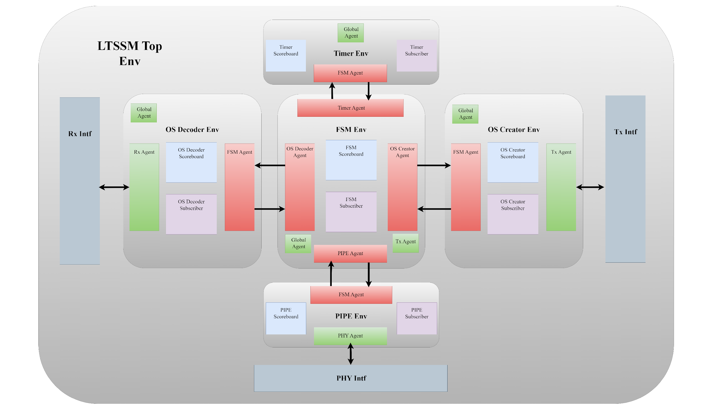
Chip-Level Verification: LTSSM
‹#›

Slide 41
Chip-Level Verification: LTSSM
To monitor the internal signals of each passive agent, we needed to bind their signals with their interfaces.
This required creating an intermediate interface that instantiates the main interface and connects its signals with the module signals.
For example, a top_timer_intf was created with the same port list as the timer module.
This top_timer_intf is bound to the timer module in the testbench.
Inside this top interface, the timer_intf is instantiated and in an always_comb process, the timer interface signals are driven by the port list of the top timer interface, which is already bound to the timer module.
This setup ensured that the timer interface samples the same internal signals present in the timer.
The same approach was applied to all internal modules to sample all internal data for coverage collection and checking mechanisms.
‹#›

Slide 42
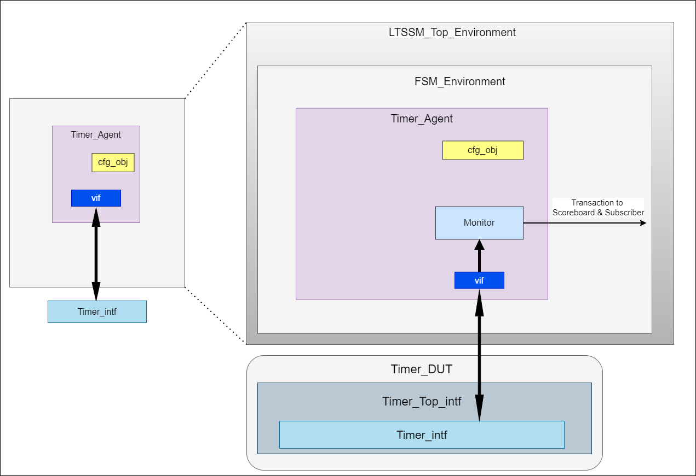
Chip-Level Verification: LTSSM
Passive Agent
‹#›

Slide 43
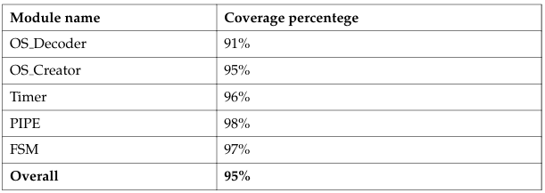
Chip-Level Verification: LTSSM
Evaluation:
The table below shows the coverage for each block inside the chip with an overall of 95% code coverage which exceeds our target of 90%.
‹#›

Slide 44
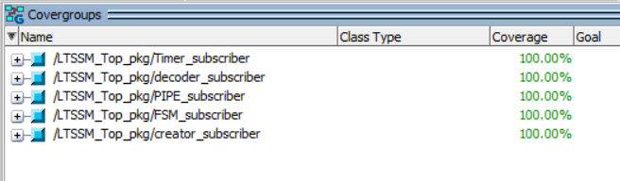
Chip-Level Verification: LTSSM
Evaluation:
As shown in the functional coverage figure, 100% coverage is achieved.
‹#›

Slide 45
07
Conclusion and Future Work
Verification Methodology and Testbench Architecture
‹#›

Slide 46
Conclusion
In this thesis, we successfully verified the Logical Sub-Block of the PCIe Gen1 PHY Layer using a UVM-based approach.
The primary objectives included identifying the mandatory functionalities from the specifications, understanding the implemented design, developing a comprehensive verification plan, and achieving high code and functional coverage.
Through rigorous block-level and chip-level verification processes, we were able to meet and exceed our coverage targets.
Our verification process involved constructing detailed environments for individual blocks (such as PIPE, Decoder, Creator, Timer, and FSM) and integrating these into a top-level environment.
Moreover, our work highlighted some errors, particularly within the Creator, Decoder, FSM, and Tx Buffers modules, most of which were addressed and resolved to ensure the overall functionality of the system.
‹#›

Slide 47
Future Work
While this thesis has accomplished significant milestones in verifying the PCIe PHY Layer, there are several areas for future work that can build upon our findings:
Receiver Block Enhancement: Further work is needed regarding the receiver (Rx) block. Enhancements in this area could include performing block- and chip-level verification.
Top-Level Environment Implementation: Implementing a comprehensive top-level environment that includes the LTSSM, Tx, and Rx blocks combined. This would facilitate more rigorous testing and verification, ensuring that all components interact correctly and efficiently within the system.
Two-Device System: Implementing a more scalable UVM-environment that includes two PCIe devices that communicate with each other.
Scalability Testing: Conduct extensive scalability testing to ensure that the PHY layer design can handle increasing data loads and higher bandwidth requirements as demanded by evolving PCIe standards.
‹#›

Slide 48
08
References
‹#›

Slide 49
References
[1] S. N. Nag, “Technical analysis of pcie to pcie 6: A next-generation interface evolution,” World Journal of Engineering and Technology, vol. 11, pp. 504–525, 2023.
[2] Statista, “Volume of data/information created, captured, copied, and consumed worldwide from 2010 to 2020, with forecasts from 2021 to 2025,” 2021.
[3] K. Lender and C. Morrison, “Retimers to the rescue: Pci express® specifications reach their full potential,” in PCI-SIG® Educational Webinar Series 2019, 2019.
[4] Synopsys, PCI Express Complete Solution. 2021.
[5] M.Jackson and R. Budruk, PCI Express Technology. MindShare, Inc., 2012.
[6] PCI-SIG, PCI Express® Base Specification Revision 6.0. 2021.
[7] PCI-SIG, PCI Express® Base Specification Revision 1.0. 2002.
[8] Intel, PHY Interface for The PCI Express 3.0 Architecture Revision .9. 2010.
‹#›

Slide 50
References
[9] IEEE Standard for SystemVerilog–Unified Hardware Design, Specification, and Verification Language. IEEE Std 1800-2017, 2018.
[10] H. Foster, The 2022 Wilson Research Group Functional Verification Study. Siemens
EDA, 2022.
[11] IEEE Standard for Universal Verification Methodology Language Reference Manual.
IEEE Std 1800.2-2020, 2020.
[12] J. G. B. Wile and W. Roesner, Comprehensive Functional Verification. Elsevier, 2005.
[13] J. Bergeron, Writing Testbenches using SystemVerilog. Springer, 2006.
[14] C. Spear and G. Tumbush, SystemVerilog for Verification. Springer, 2012.
[15] A. B. Mehta, ASIC/SoC Functional Design Verification. Springer, 2018.
[16] S. EDA, UVMCookbook. 2018.
‹#›

Slide 51
References
[17] Accellera, Universal Verification Methodology (UVM) 1.2 User’s Guide. 2015.
[18] R. Javali and J. T. Colaco, “Efficient implementation of high speed pci express mac transmitter with pipe interface,” in IEEE Sponsored 3rd International Conference on Electronics and Communication Systems, 2016.
[19] K. N. Chandana and R. K. Karunavathi, “Link initialization and training in mac layer of pcie 3.0,” International Journal of Computer Science and Information Technologies, vol. 6, no. 3, pp. 2717–2719, 2015.
[20] M. D. R. Geetanjali and G. Umesh, “Functional verification of mac-phy layer of pci express gen5.0 with pipe interface using uvm,” in 2020 International Conference for Emerging Technology, 2020.
[21] C. E. Cummings and J. Bergeron, “Using uvm virtual sequencers and virtual sequences,” Sunburst Design, 2016.
‹#›

Slide 52
Thank You!

